Slide 1

Identifying Noise Sources in Cryogenic Ion-Trap Systems
Aida Mashaal
Trapped Ion Quantum Information
C. Axline , J. Home
20. July 2022

Slide 2


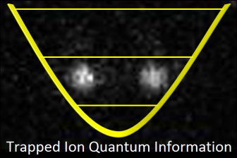
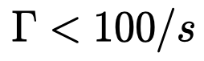
BSc. Physics
MSc. Physics
Thesis
Quantum Optics Lab
Prof. Schmiedmayer
Semester Project
Spin Physics Group
C. Degen
Semester Project
Trapped Ion Quantum Information
J. Home
Master Thesis
Trapped Ion Quantum Information
WIQR Subgroup
J. Home , C. Axline
For typical gate speeds:
Notes:
My journey in physics started in 2017 when i started my bachelor degree in the technical university of vienna. My first encounter with research and experiments was during my bachelor thesis where i joined a quantum optics laboratory working on building a fourier transform interferometer and performing rubidium spectroscopy. Following that, I moved for my master’s degree to eth, where i joined the spin physics group in yet another optics projects regarding nv centers. I proceeded to work on another semester project in the trapped ion quantum information group where i am currently doing my master thesis.

Slide 3
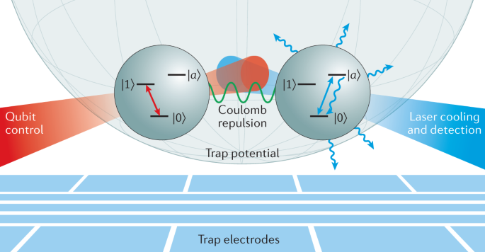
Motivation
Fault tolerant quantum computing : faulty operations up to a certain threshold
Heating rates limit fidelity of two-qubit gates
For typical gate speeds:
K.R. Brown et al., 2021 Nat. Rev. Mater. 6 892–905
Notes:
Now, we know that for universal quantum computing operations(gates) can be faulty up to a certain threshold, this is called fault tolerant quantum computing. In ions for performng two qubit gates the motional state of the ion is essential. For typical gate speeds this requires heating rates lower than 100 quanta/s . Many sources contribute to increasing these heating rates including external (system) and internal (Trap) sources. The goal of my project is to identify these sources in cryogenic systems specifically our system and aim to mitigate them.

Slide 4
Agenda
Trapping Physics
Trap Geometries
Heating Rates
Voltage NSD to Field NSD
Setup
Measured Heating Rates
Possible Noise Sources
Johnson Noise – RF
Johnson Noise – DC
Outlook
Notes:
ill give you a quick overview of what i will cover today, we will start with basics of ion trapping and some trap geometries, followed by an introduction to heating rates, conversiona we need and how to meaasure HR on ions. I will introduce our setup and present some possible noise sources to look at. lastly I will mention the next points we aim to concern ourselves with.

Slide 5
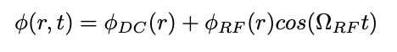

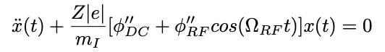
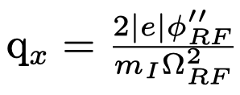
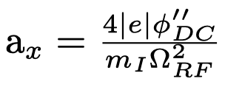
Linear Paul Traps
DC
RF
RF
DC
Equation of motion :
Introduce dimensionless parameters :
Notes:
Ion traps commonly use the linear paul trap con figuration which uses a combination of static and oscilaating quadrupole potentials. This allows trapping in all directions. The axial axis is easily just a harmonic potential set by the static field however trapping in the radial plane can be understood by looking at the equation of motion. If we introduce these two dimensionless variables which are dependent on the second derivative of the field and the inverse squared of the trap drive freq., we find for the limit smaller 1 bound solutions for the motion where it is composed of two oscillating motion: the secular motion with large amplitude oscillations and the micromotion with smaller amplitdues. The secular motion is at much slower timescales than the micromotion such that the ion stays on average trapped in the radial plane. typical values of the secular/trap frequency is about 1Mhz whereas the micromotion is on the timescale of the rf drive with typical values 20Mhz-50Mhz.

Slide 6
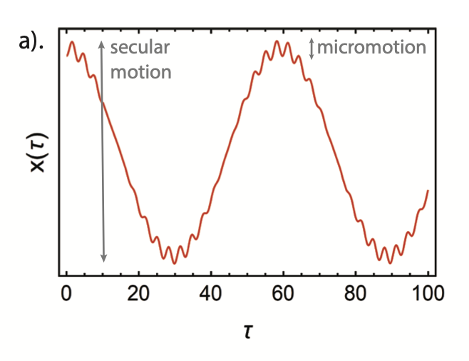
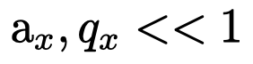
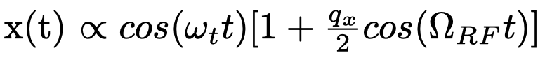
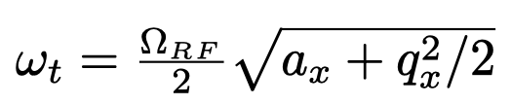
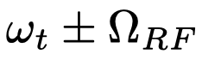
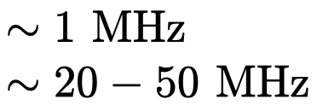
Linear Paul Traps
Secular motion
micromotion
Stray E-field
More micromotion
Compensate through add. DC fields
C. DECAROLI (2021) , PhD Thesis, ETH Zurich
Notes:
This approximation is at the center of the trap but if we have some stray field that psuhes our ion away from the center. Micromotion becomes important leading to unwanted effects like shifting the trap frequencies therefore it is usually compensated for by adding extra dc electrodes.
induce the ion to shift away from the pseudopotential minimum location. Causes jiggling of the ion since the micromotion is increasing the amplitude. Cuases motional heating. Usually compensate the electric fields using extra dc electrodes.
it results in altering transition lineshapes and Rabi frequencies and can shift mode frequencies [Ber98; Hom13]. Excess micromotion can be compensated using additional static voltages
Motion composed of two oscillating motions :
Secular motion : large amplitude oscillation at frequency wt slow motion
Micromotion : second smaller amplitude at drive frequency fast motion
In the radial plane (the x − y plane), the ion undergoes an harmonic oscillation at the secular frequency ωx modulated by smaller oscillations at a frequency near the RF-drive frequency.
Along the trap axis, the static potential determines the harmonic motion of the ion at the axial frequency:
Basically motion is modulated by faster trap frequency oscillations

Slide 7
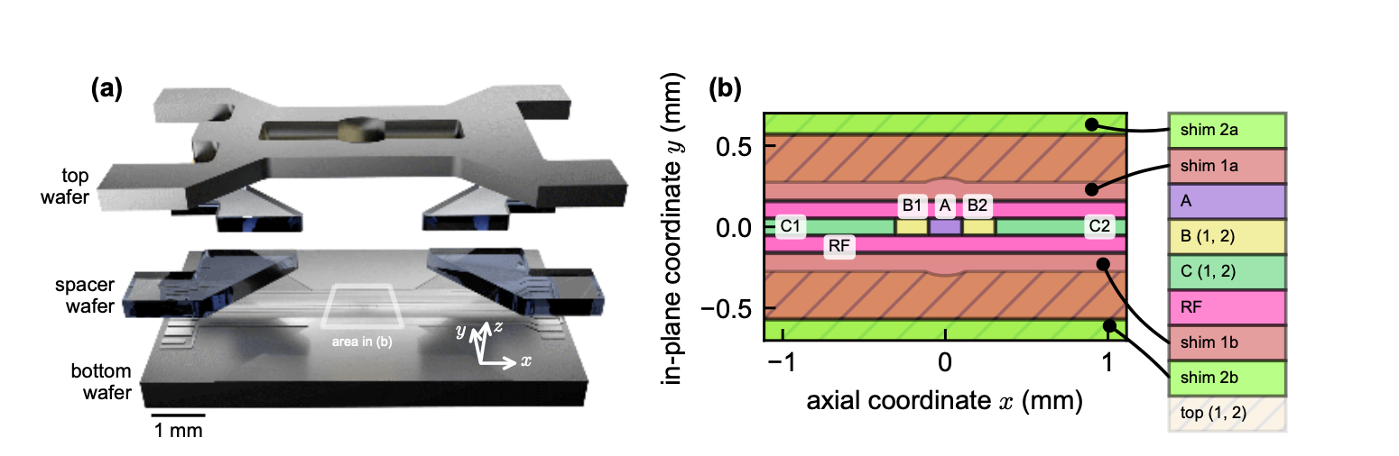
Evolution of Trap Geometries
PIEDMONS Trap
3D Trap
DC
RF
RF
DC
Surface Trap
DC
RF
DC
RF
DC
S. Auchter et al., 2022 Quantum Sci. Technol. 7 035015c
Notes:
Now weve seen the 3d rod geometry of an ion trap, this can be opened up into a surface trap where all electrodes are on one surface. This configuration helps with fabricating more complex traps which are needed for scaling up. however the disadvantage is it has shallower depth making it easier to lose the ion + since the ion is closer to the surface any imperfections on the surface affect the ion more severley.
Our trap is a 3D surface trap combining the depth of a 3d trap with the facbrication techniques of surface traps. The schematic is a top view of the electrodes which will look at closely later.

Slide 8
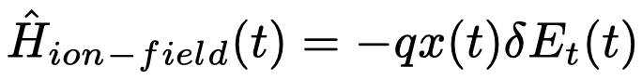
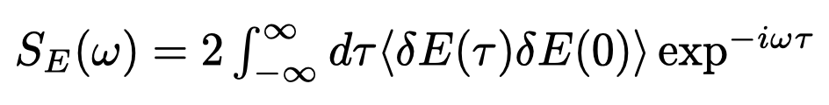
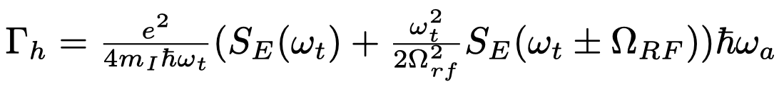
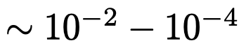
Heating Rates
E-Field Fluctuations
In terms of NSD
Excites motional state at rate
Non-negligible micromotion, away from rf null
Typically
Notes:
Trapping is not perfect and voltage noise on the electrodes can cause electric field fluctuations, these couple to the motional state of the ion through this hamiltonian. A quantity often used for fluctuations is the noise spectral density which is basically the autocorrelation function. The relation between the rate at which the motion is excited and the NSD is given by this. Where we thee first term as a function of only the trap frequency where as the second function is at the trap frequency modulated by the drive frequency. This relation comes only from the rf electrodes once the ion is not at the trap center. Now this typically around 10^(-2/-4) so typically this is negligible compared to the first term.

Slide 9
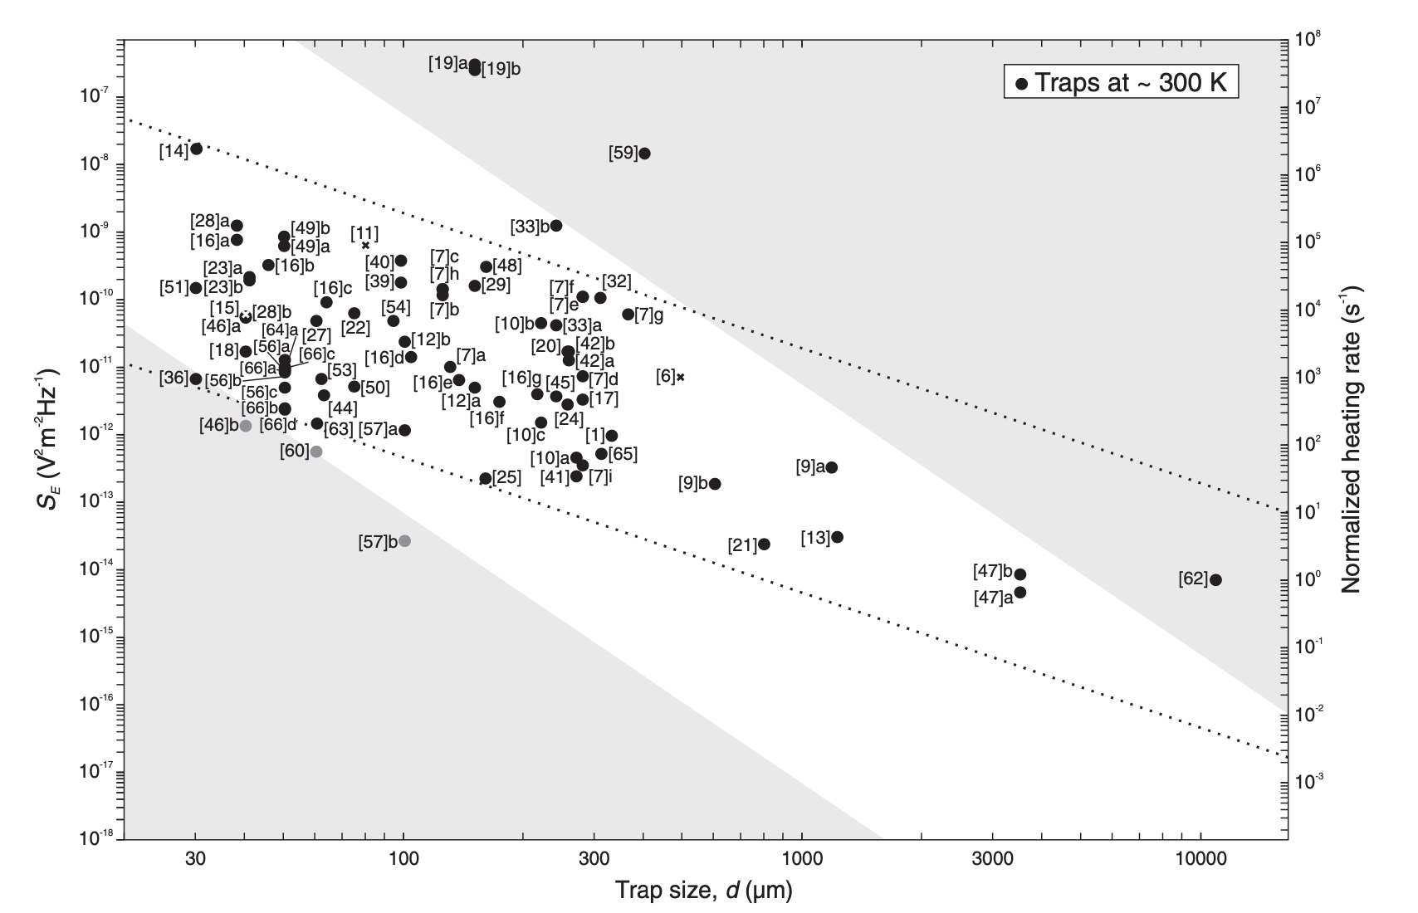
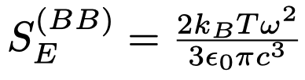
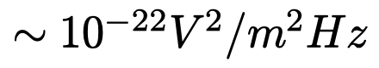
Heating Rates
Lower limit :
Notes:
Suppose E field fluctuations are present in our system. a qunatity we use to describe the noise fluctuation is the electric field noise spectral density. This electric field noise couples to the motion of the ion and causes motional excitation. The rate at which phonons are added to our ion, heating rate, is given by the relation.

Slide 10
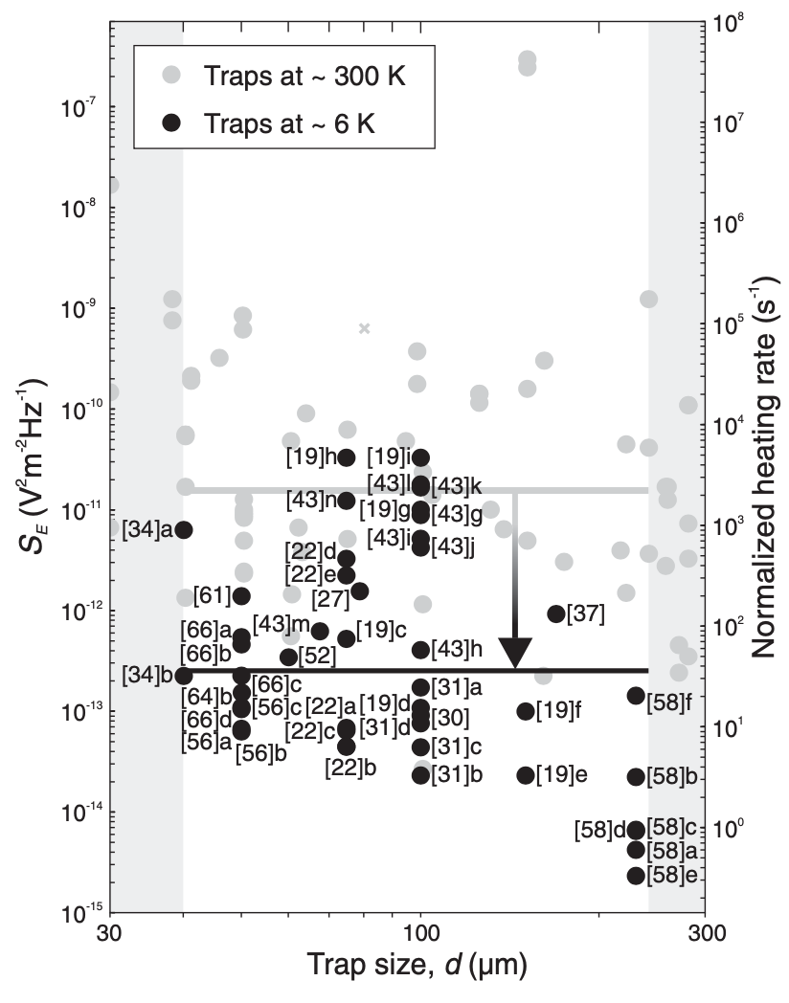
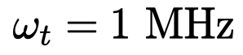
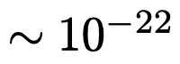
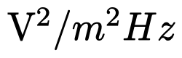
Typical Values for Heating Rates
Better performance at lower T
Fundamental lower limit :
Origin ?
M. Brownnutt et al., Rev. Mod. Phys. 2015
Notes:
Suppose E field fluctuations are present in our system. a qunatity we use to describe the noise fluctuation is the electric field noise spectral density. This electric field noise couples to the motion of the ion and causes motional excitation. The rate at which phonons are added to our ion, heating rate, is given by the relation.

Slide 11
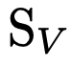
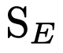
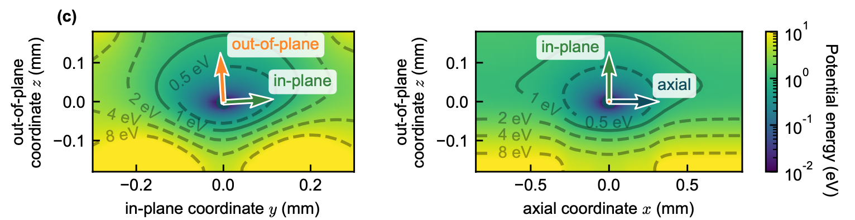
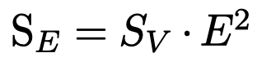
Voltage NSD to Field NSD
Simulation of Potential
1V on electrode Scaling factor E
S. Auchter et al., 2022 Quantum Sci. Technol. 7 035015c

Slide 12
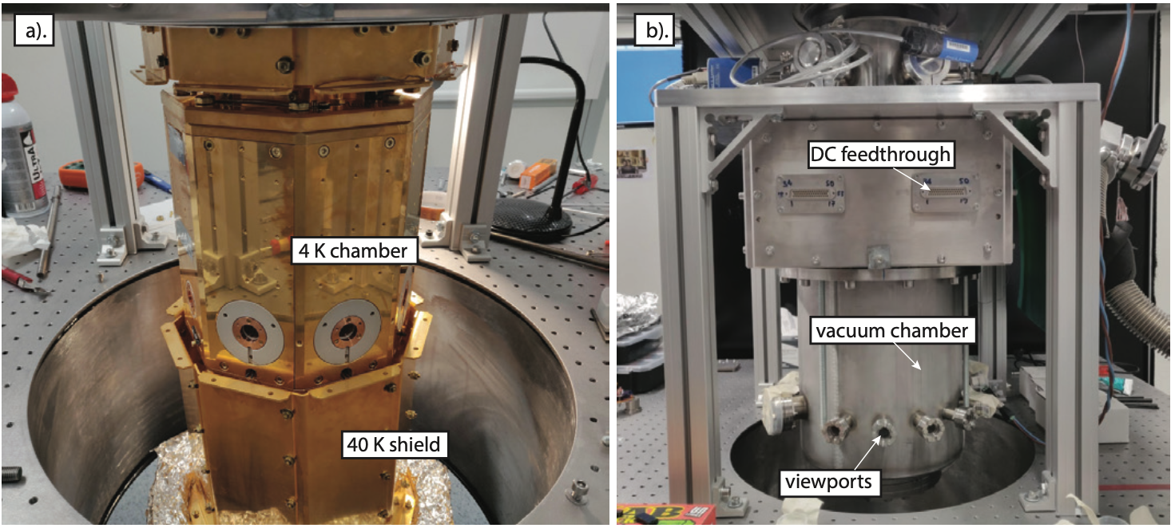
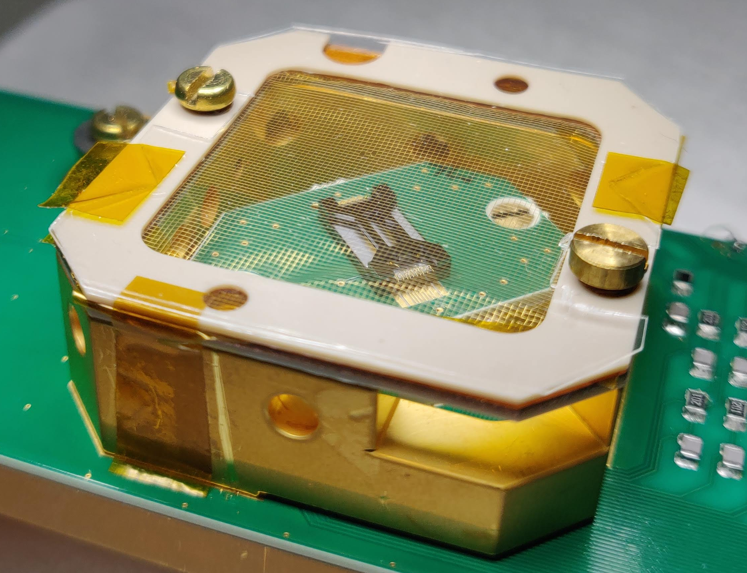
Setup
Notes:
State advantages

Slide 13
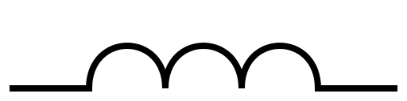

Voltage Lines
DC Lines
OFB 300K
CFB 4K
300K – 4K
DAC
DC Electrode
FFC
Amps
RF Lines
Resonator 4K
RF
RF Electrode
Amps
+33dBm
Notes:
The DC voltages are provided to the trap via Flexible cables 5. These cables are made of gold-plated copper and polyimide (Kapton), each can host up to 51 signal lines. The cable is inserted into the paired connector on the filtering board. We use 3 flexible cables in series in order to connect the DC electrodes on the trap to the room-temperature secondary filters. Each cable is a maximum of 10 inches (25.4 cm) long, for a total of about ≈ 70 cm from the trap to the room-temperature DC filters.

Slide 14
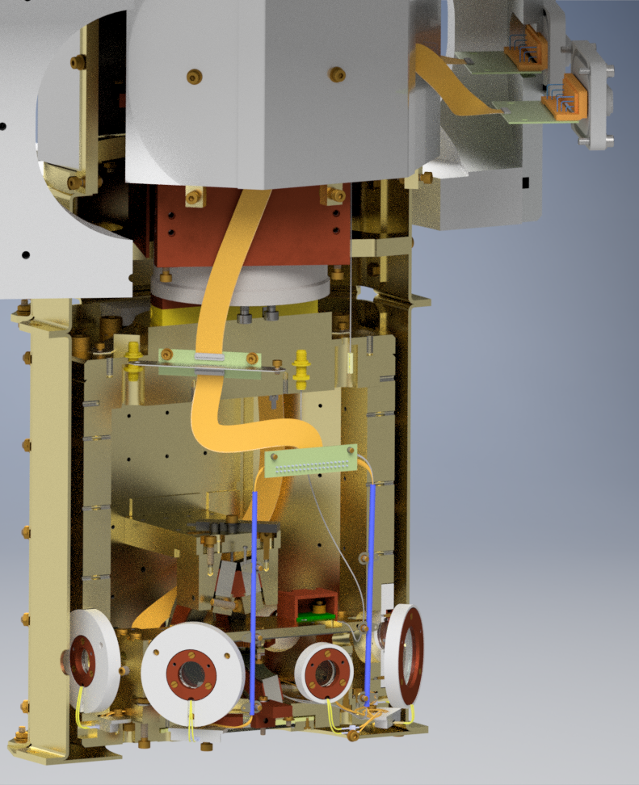
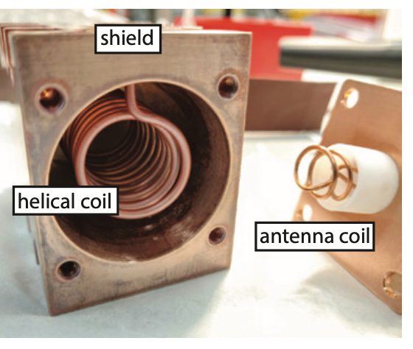
300K
40K
4K
C. DECAROLI (2021) , PhD Thesis, ETH Zurich

Slide 15
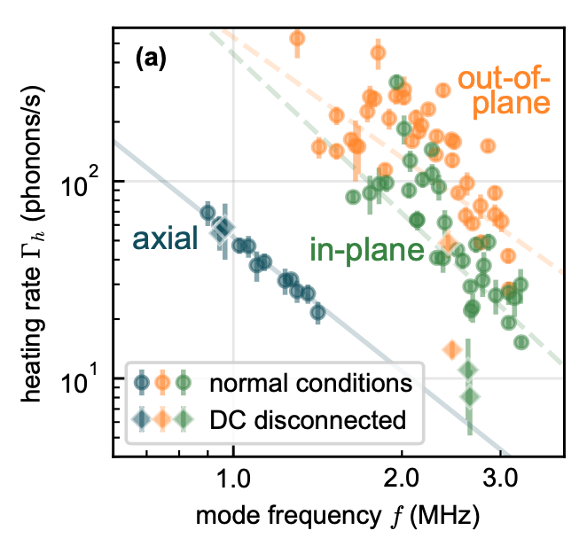
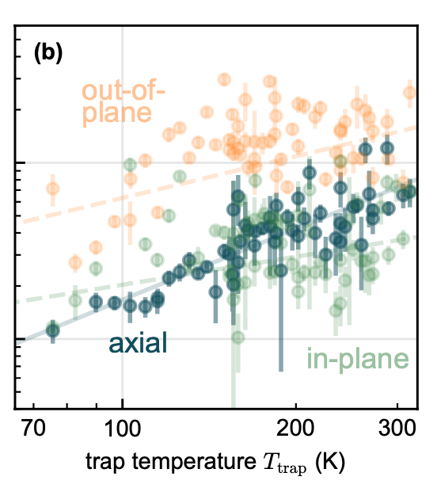
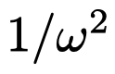
Measured Heating Rates
S. Auchter et al., 2022 Quantum Sci. Technol. 7 035015c
Notes:
Implications: - In this case, one would expect trap temperature to affect modes for which surface-based noise sources limit the heating rate, while trap temperature would hardly change the effect of external sources. This points to an externally generated noise source, which may be carried along transmission lines to the DC electrodes [73].
Seven measurements were performed in the presence of radial shimming fields up to ±45 V/m, which displaced the ion about 0.5 μm from the RF null. They did not show a strong dependence on the stray field magnitude, and gave respective mean values 44, 108, and 28phonons/s, and standard deviations 17, 6, and 14phonons/s, respectively. This suggests that neither noise delivered through the RF electrodes nor drifts in static stray fields over time play a significant role in the measured heating rates.
Heating rates of the axial mode were unaffected by the disconnection of an external noise source, which along with its frequency and temperature dependence suggests a limiting noise source originating on trap surfaces or in bulk dielectric

Slide 16
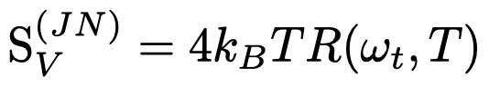
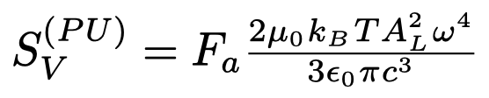
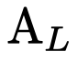
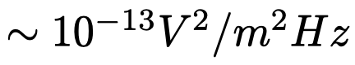
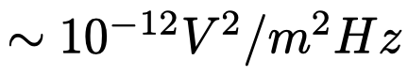
Possible Noise Sources
Johnson Noise
Electromagnetic Pickup
Thermal noise of circuit components (electrodes, filtercircuits, power supplies)
B-field noise picked up by loop in system
Effective resistance of full circuit
Loop area

Slide 17
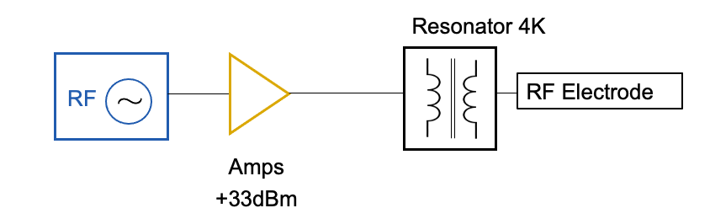
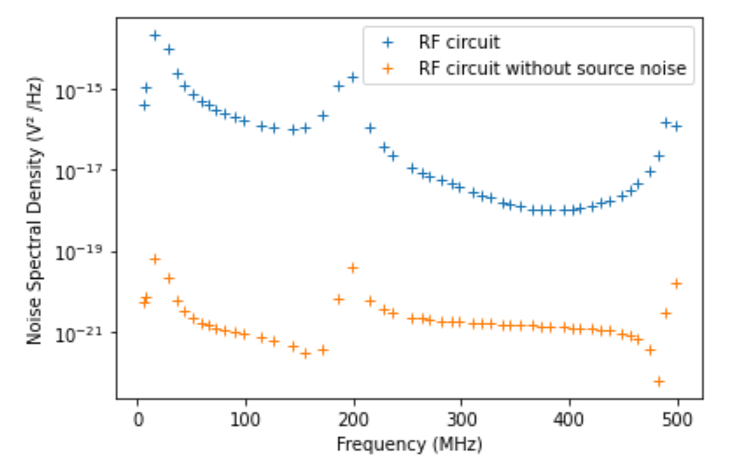
Johnson Noise - RF
20MHz

Slide 18
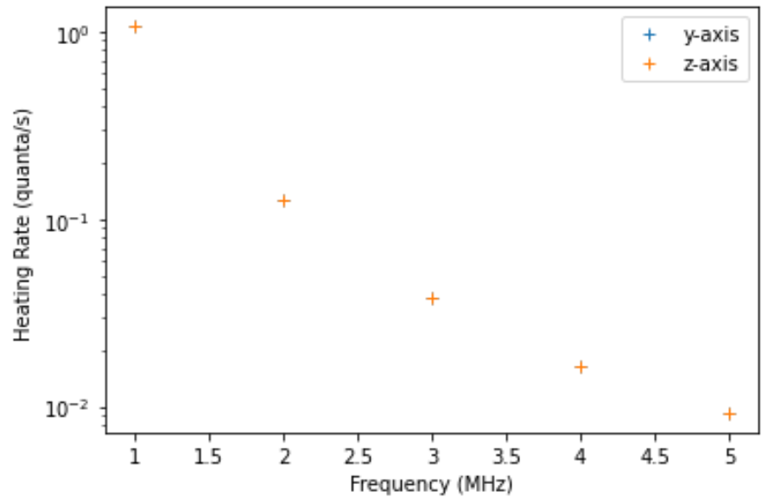
Johnson Noise - RF
Assume 5nm displacement from the RF null
Agrees with further observation

Slide 19
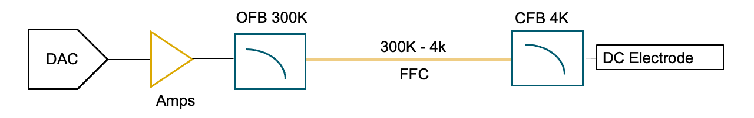
Johnson Noise - DC
Measure
Propagate through simulation of CFB till electrodes

Slide 20
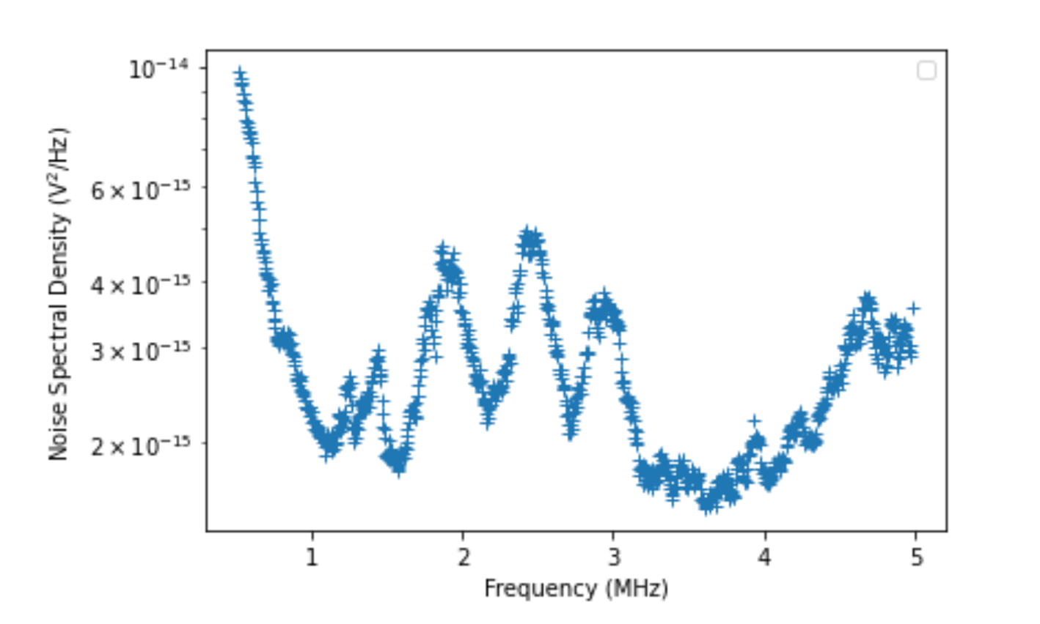
Johnson Noise - DC
Measure
Propagate through simulation of CFB till electrodes

Slide 21
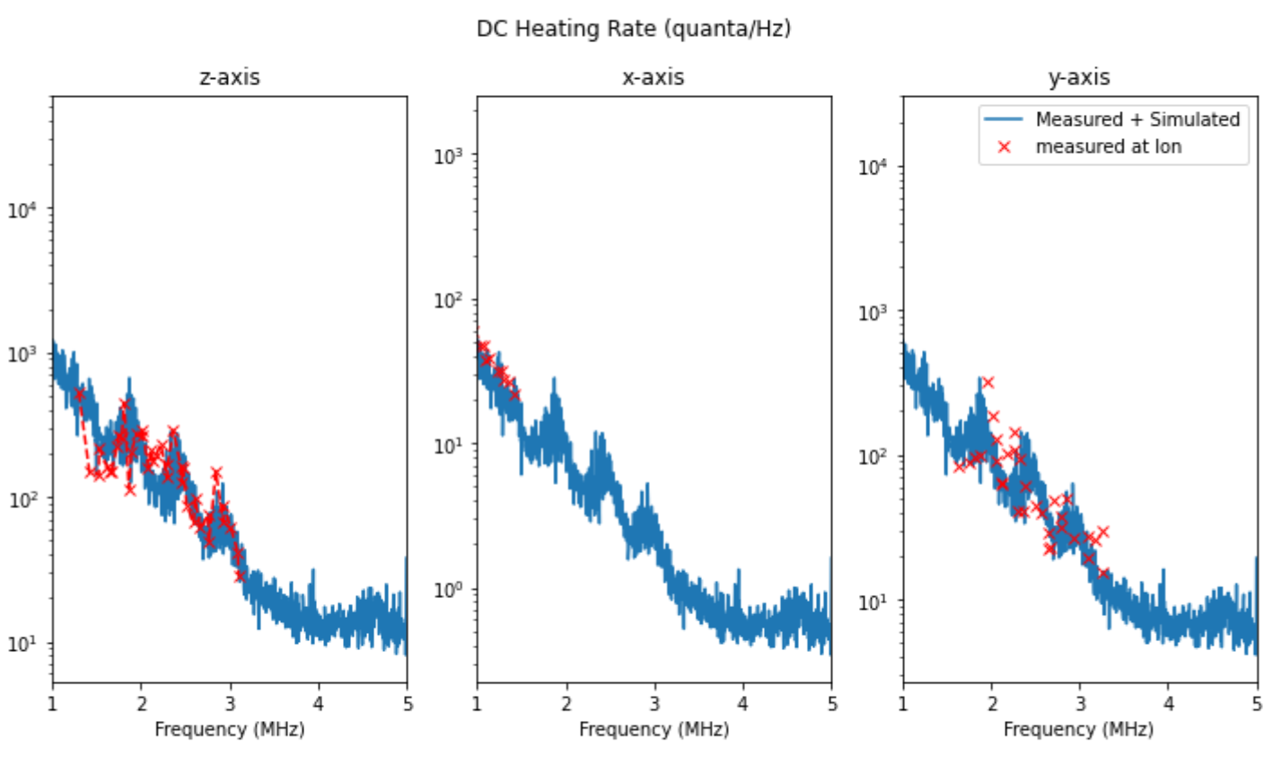
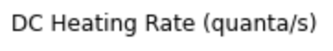
Assume worst case: coherent noise
Filterboard not filtering noise as planned!

Slide 22
Outlook
Find filtering circuit to lower noise measured at feedthrough
Model Electromagnetic Pickup in the System
Analyze different grounding situations
Measure + simulate noise of a similar setup
Switch out DAC with Fastinos (faster DACs)
Mitigation Techniques (shielding, ...)
Measured HR at ion following changes based on data

Slide 24
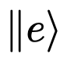






Heating Rate Measurements
Lamb Dicke regime
n = 2
n = 1
n = 0
FT

Slide 25


Heating Rate Measurements
Lamb Dicke regime
n = 2
n = 1
n = 0
M. Brownnutt et al., Rev. Mod. Phys. 2015

